Slide 1







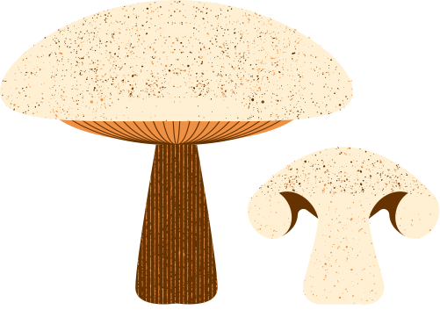

NutriSmart
phase B
Supervisor Dr. Natali levi
Inbar Mizrahi, Khalid Sweid

Slide 2
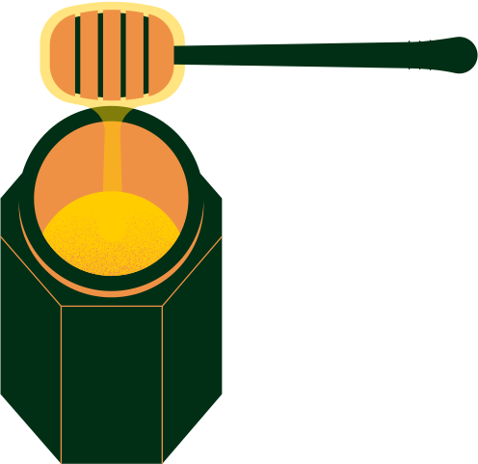
Introduction
Nutrition app
Nutrition has a substantial influence on our overall well-being
Photo Recognition
Chatting
Chat and find out the best nutrition options out there.
Photo recognition from every place, anytime.
2
Notes:
as we all know, nutrition has a big impact on our daily life,
A lot go illnesses can be cure only from changing your food habits, and of course, over weight causing cardio issues, diabetes and other disease.
another aspect is the fact that some population have specific dietary requirements - pregnant woman or people with celiac allergies and more.
they all need to take care and notice what they consume.

Slide 3
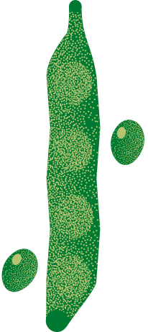
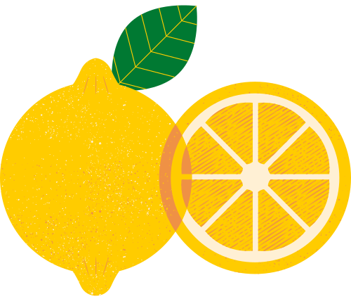
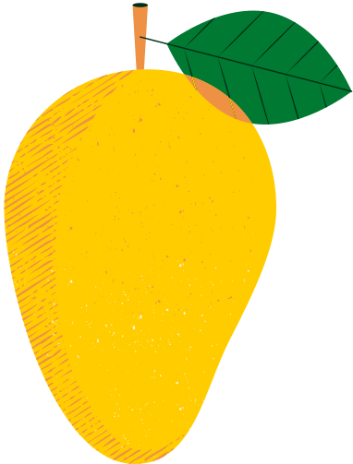
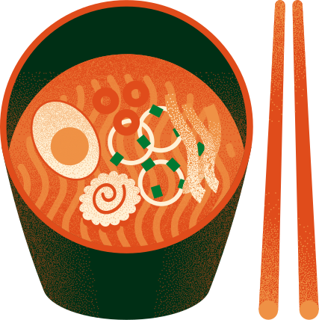
Have we addressed the problem we perceive?
other applications were:
Targeting mainly weight loss
No Israeli products in the apps
loosing muscles instead of fat
3

Slide 4
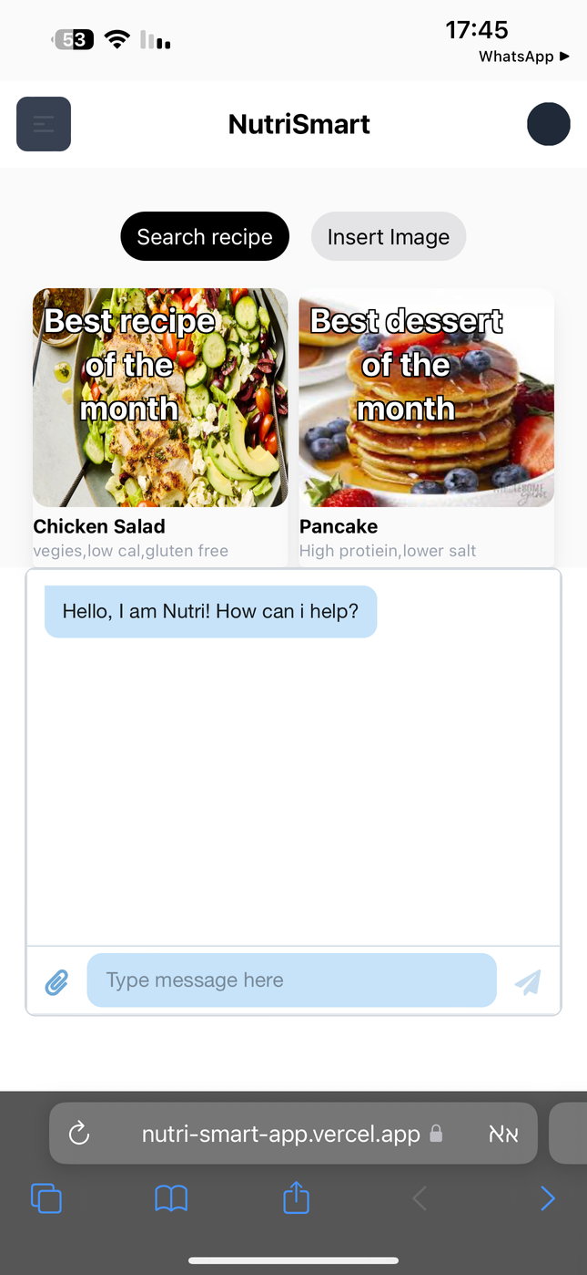
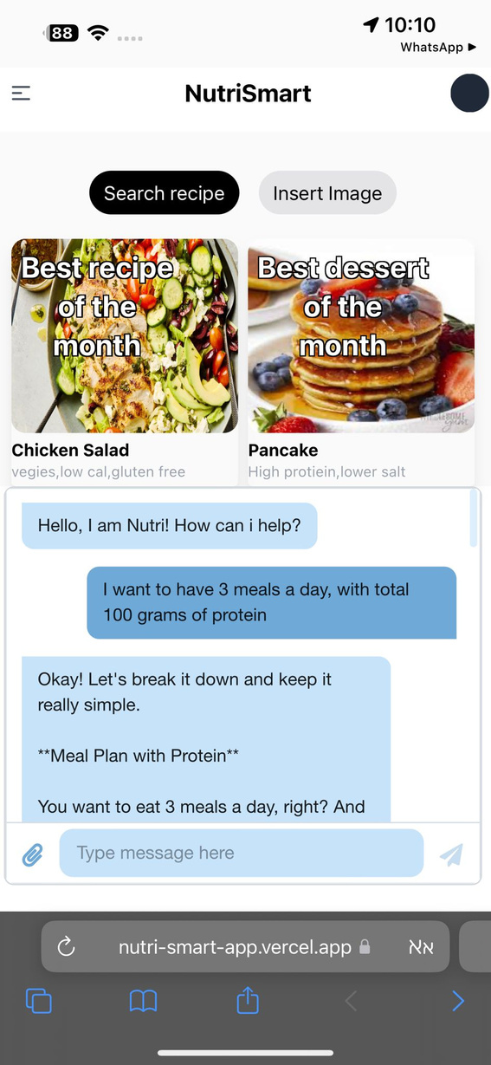
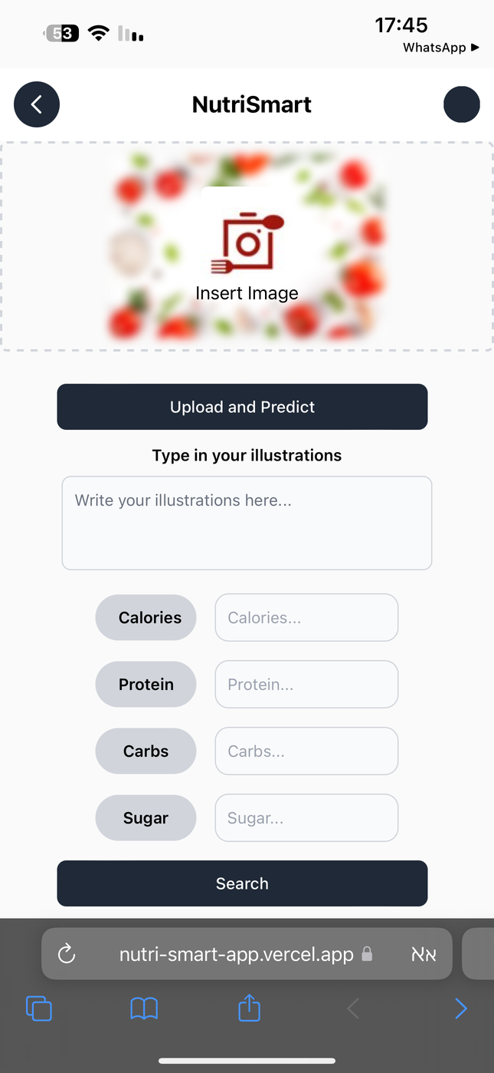
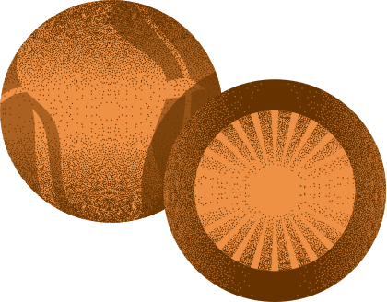
How it works?
4

Slide 5
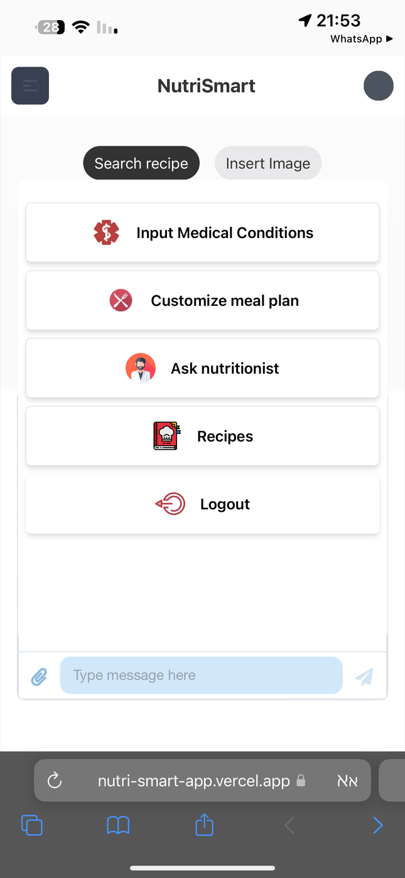
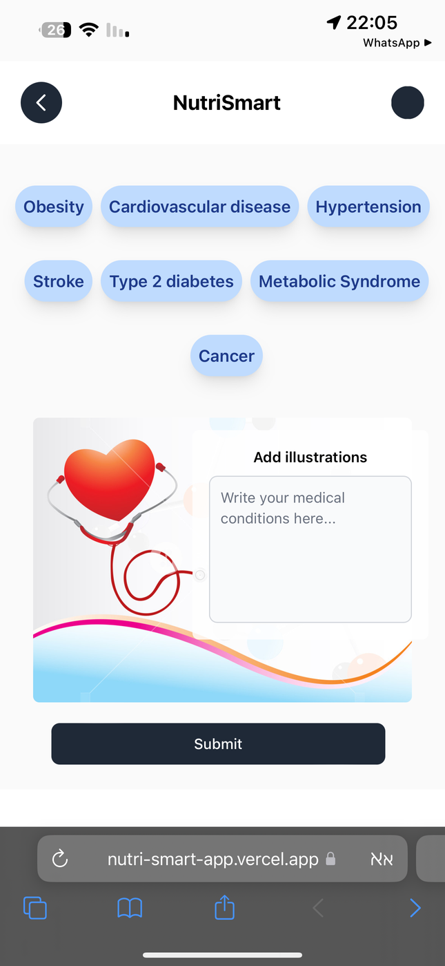
How it works?
5

Slide 6
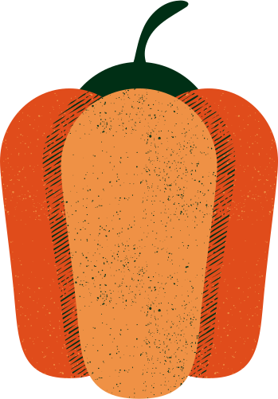

Deploy
Photo recognition Algorithm
Challenges
Chat GPT server
Work load
Data Base Managing
6
Notes:
System development: Integrating APIs with a system, especially with complex models like GPT-4, and ensuring smooth synchronization with the database can be problematic. The API might provide inconsistent data, and network issues could disrupt communication.
Data verification and validation: Verifying the information received from GPT-4 against a trusted database is crucial, as the model might produce incorrect or contextually inappropriate responses.
Algorithms and technologies: Finding the relevant and effective algorithms and technologies for our goal
Recipe suitability classification: Identifying and marking recipes that are not suitable for pregnant women or other specific dietary needs. Ensuring that similar unsuitable recipes are also flagged.
Handling data consistency and concurrency: Maintaining data consistency between the application and the database when multiple users are interacting with the system simultaneously.
Recipe making process: finding a suitable way and APIs for making recipes
Ensuring accurate recommendations: we want to ensure that our app give accurate result and recommendations

Slide 7




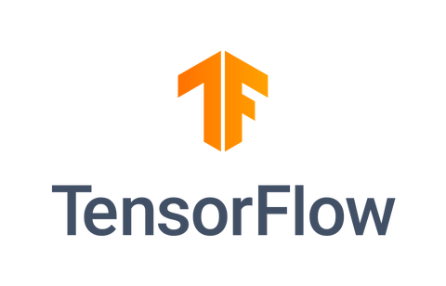





System Architecture
User
Developer
User Interface
Frontend
Frontend
Backend
Data Layer
GUI
7
Logic Layer

Slide 8

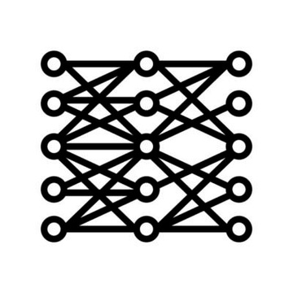



Algorithm
CNN
Photo
Chat
API
8

Slide 9
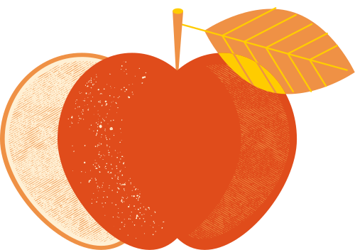


Technologies
Food recognition in apps
Dataset taken from UECFOOD100 library
around 8000 pictures of 100 categories
Diverse images with various angles, lighting, and backgrounds

Slide 10
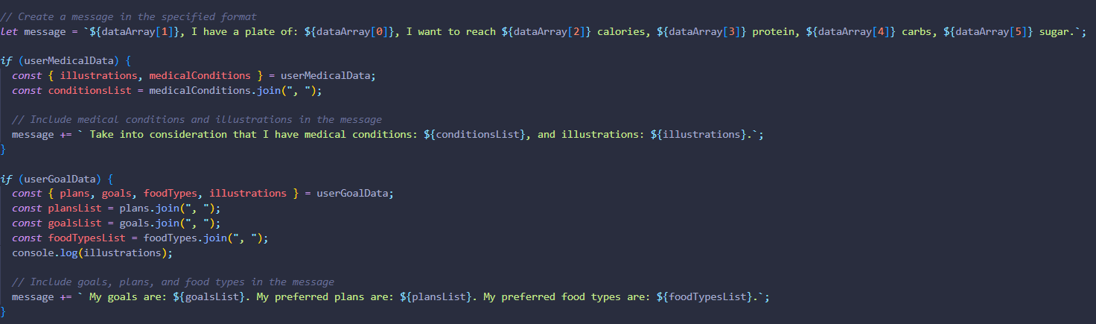
Prompting Chat-GPT
Consider the user preferences, medical condition, photo recognition items, and user goals

Slide 11
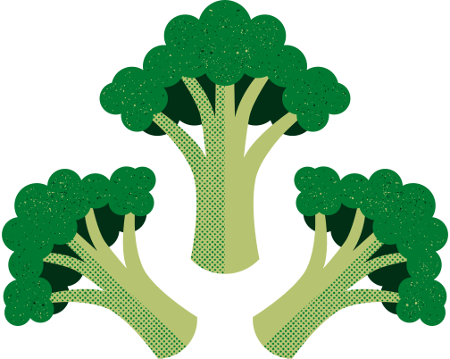
Why Chat-GPT?
Cost: Pay-as-You-Go Model
AI Alignment and Safety: OpenAI invests heavily in ensuring that its models align with ethical standards
OpenAI models are trained on a vast and diverse dataset, enabling them to provide informed answers
ChatGPT can engage in natural, human-like conversations, making it easier for users to interact with

Slide 12
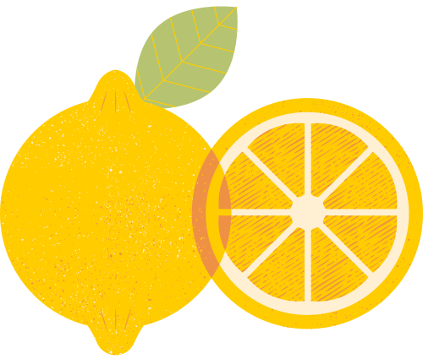
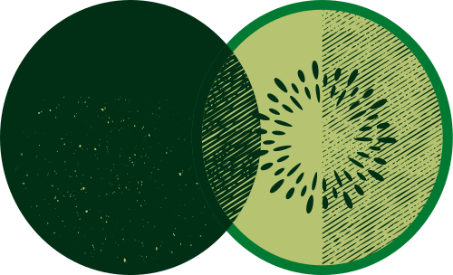
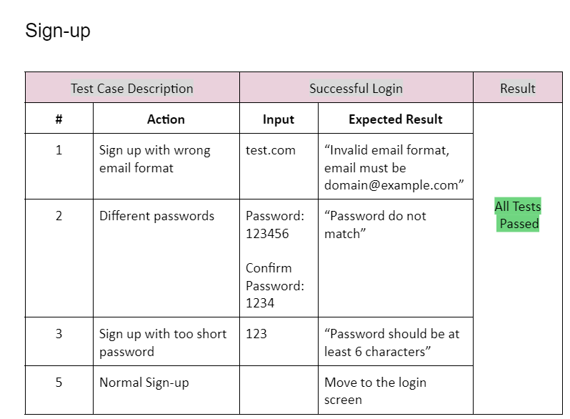


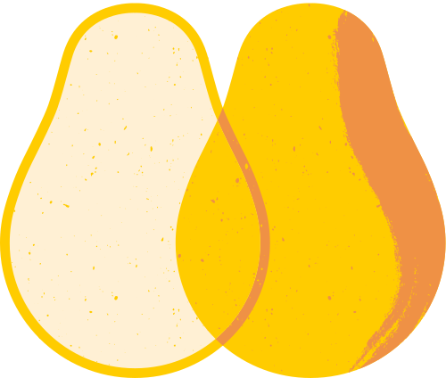
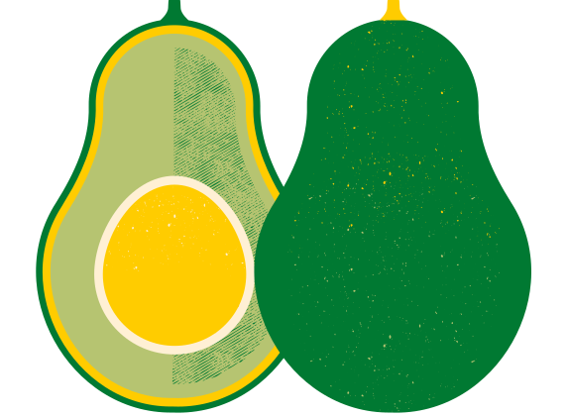
Test Plan-user sign up
9

Slide 13
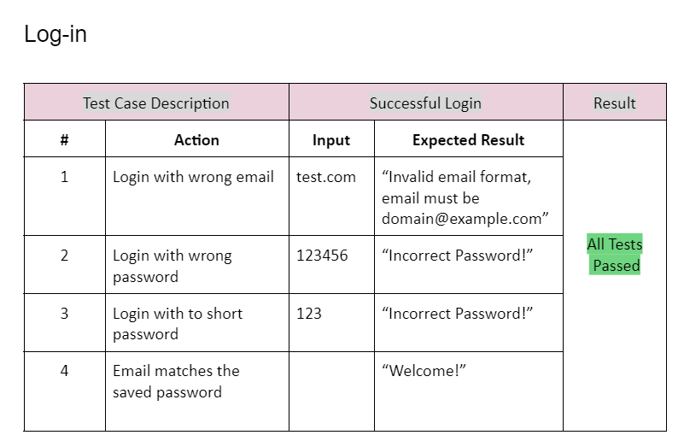
Test Plan-Login
10

Slide 14
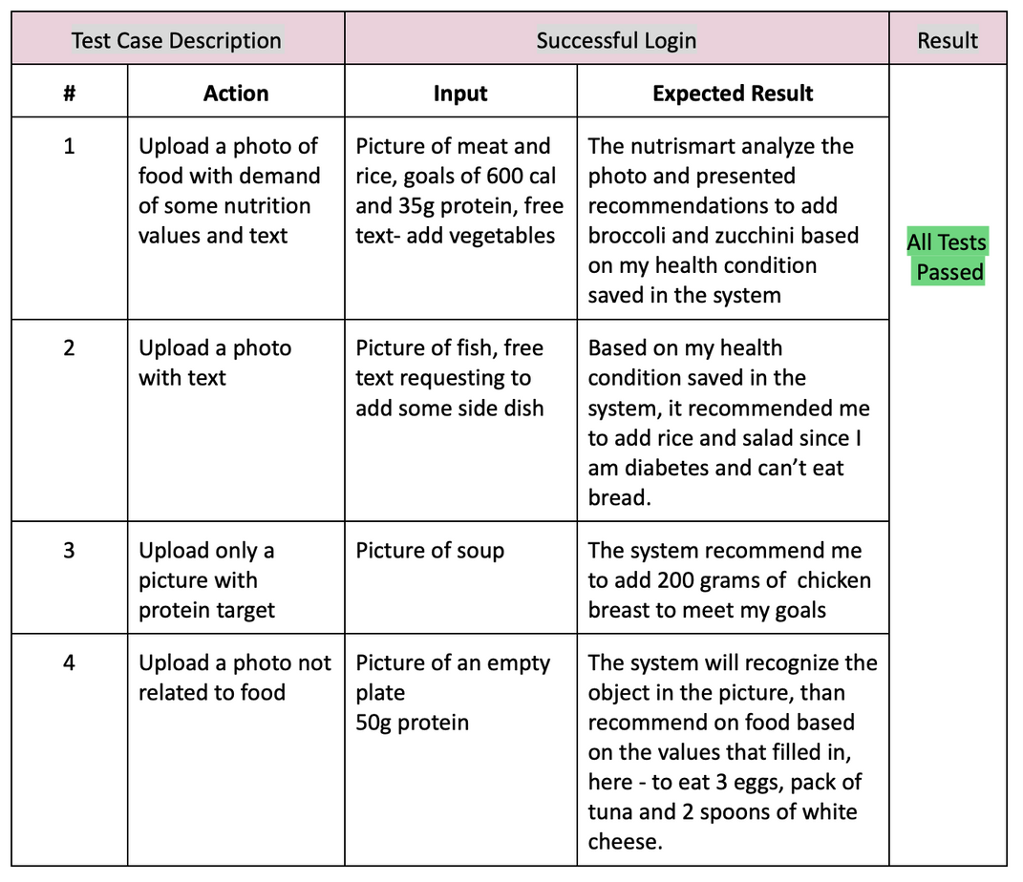
Test Plan-Photo Recognition
11

Slide 15
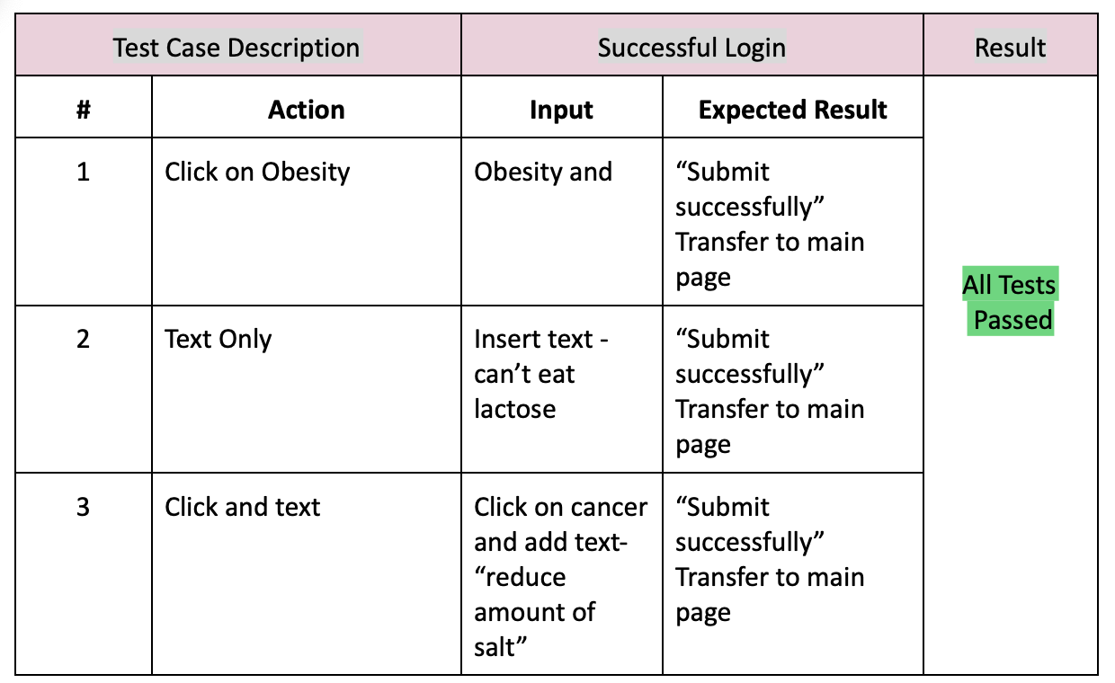
Test Plan-Health Condition
12

Slide 16

User friendly interface
personalized user experience
solution
Competitive edge
Innovative technology
Accurate information
Continuous improvement
13

Slide 17
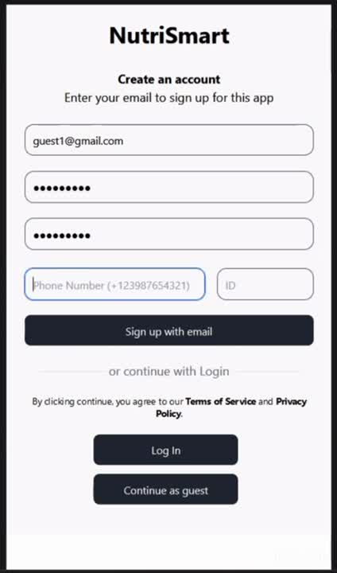
system video
14

Slide 18
Thank you for listening!

